Slide 1
Semantic Segmentation with PyTorch
CMPUT 328
Nilanjan Ray

Slide 2
Agenda
We will look at two notebooks semantic segmentation
For simplicity, we will do 2-class segmentation: foreground and background segmentation for a “flower.jpg” image
Our first attempt will be to train a convnet on classification task and then use it for segmentation
In this process, we will learn one important feature: using a convolution in place of a fully connected layer
The advantage of using a fully convolutional layer is that the network can accept an image of any size as an input
One limitation of applying a classification convent for segmentation is that the output would be smaller in size than the input
Our next attempt will overcome this low-resolution issue by introducing an important type of convolution operation called “transposed convolution” (aka “upsampling”)
We will also learn about an important aspect about labels in training a “segmentation net” that is different from training a “classification net”

Slide 3
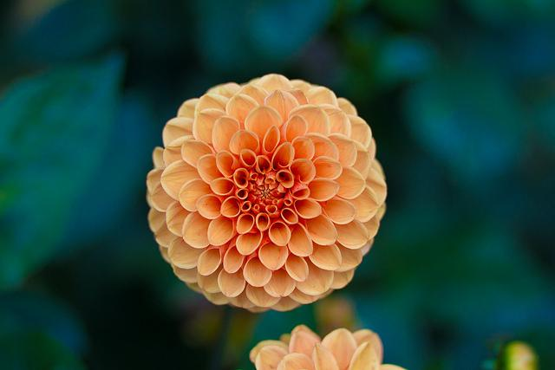

Semantic segmentation example
For this lab we will do the simplest type of segmentation: foreground and background segmentation
Semantic
Segmentation
Flower image
Binary foreground-background
segmentation

Slide 4
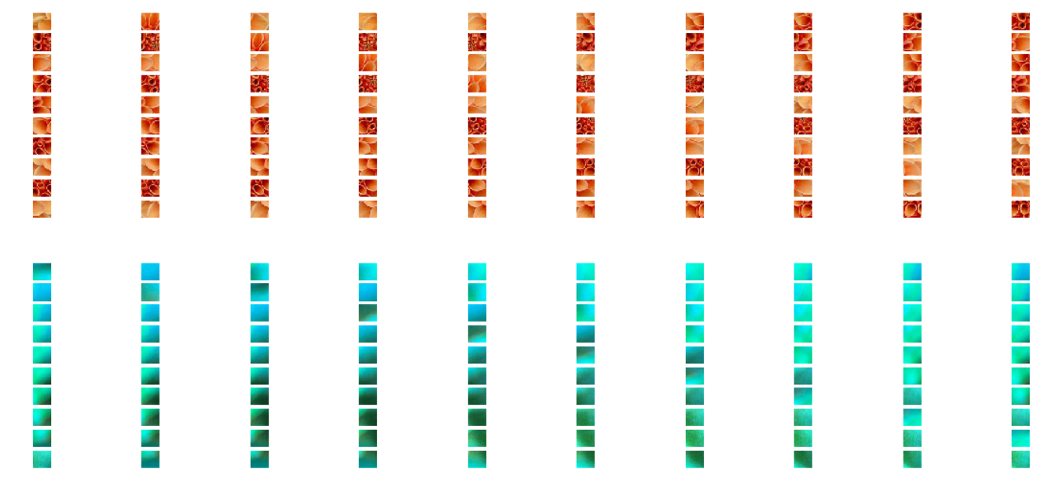
Segmentation as image classification
Training dataset: 32-by-32-by-3 RGB images with positive or negative labels
Positive examples
Negative examples

Slide 5
Segmentation as image classification…
Train a convnet on the training set
32
28
14
5x5 conv
2 filters
2x2 maxpool
Stride 2
10
2x2 maxpool
Stride 2
5
flatten
dense
layer
softmax
5x5 conv
4 filters
2
2
28
14
10
5
32
4
1
1
2
4
100
2
1
3
This classification net can only take a fixed size input image.

Slide 6
Segmentation as image classification…
Let’s convert the dense layer to a convolution layer:
32
28
14
1
5x5 conv
2 filters
2x2 maxpool
Stride 2
10
2x2 maxpool
Stride 2
5
5x5 conv
2 filters
softmax
1
5x5 conv
4 filters
1
1
28
14
10
5
32
2
2
4
2
4
2
3
This classification net can take an input of any width and height.
But, output image will have approximately 4x lower resolution.
Let’s go through “ImSegFromClassification” notebook.

Slide 7
Segmentation using convolution transpose
Convolution transpose is a type of convolution
See: https://nrupatunga.github.io/2016/05/14/convolution-arithmetic-in-deep-learning-part-1/
https://nrupatunga.github.io/convolution-2/
Convolution transpose is more commonly known as “upsampling” layer
Let’s call this net “Segmentation Net”

Slide 8
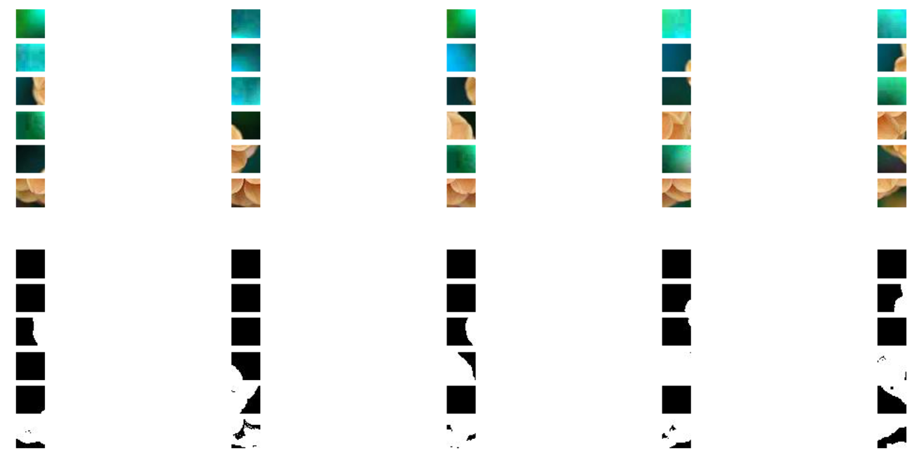
Training set for segmentation net
Training images
Label images
A training image has a corresponding label image of same height and width.

Slide 9
Segmentation net architecture
This network can take input of any height and width.
Output image does not lose resolution!
32
28
15
14
5x5 conv
2 filters
2x2 maxpool
Stride 2
12
2x2 maxpool
Stride 2
6
Conv-trans
3x3,
4 filters
stride 3
3x3 conv
4 filters
28
14
12
6
32
15
4
2
4
2
3
2
32
Conv-trans
3x3,
2 filters
stride 3
Output pad 1
softmax
32
2

Slide 10
Convolution transpose layer
Roughly speaking, the size of the output of conv-trans layer would be determined by the following relationship:
output = conv(input, kernel, stride)
input = conv_trans(output, kernel, stride)

Slide 11
Exercise
Design this architecture and train; then segment the flower image with this architecture.
32
32
32
conv
2 filters
2x2 mpool
Stride 2
Conv-
trans
Conv-
trans
softmax
conv
4 filters
2x2 mpool
Stride 2
32
32
+
32
4
4
2
2
2
2
2
3
Skip connection

